Slide 1
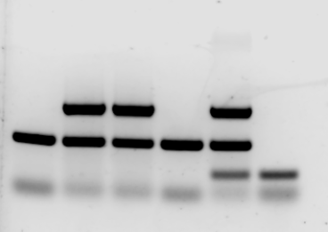
4-10-2025
Cre genotyping
No DNA
299
300
313
314
430
Cre
FABP (internal control)

